Slide 1
Building an API Gateway
Custom Authoriser in .NET Core
Elgin Lam
Technical Account Manager, Amazon Web Services

Slide 2







Recipes Website Architecture - http://grandmas-recipes.info
HTTPS
Amazon API Gateway
Lambda function
RDS Instance
Client Web Browser
Single Page Application on S3

Slide 3

The Problem

Slide 4

Secured Recipes Website Architecture
Get JWT Token
Token Endpoint
Token in Header
Recipe Endpoint
Lambda function
RDS Instance
Client Web Browser
Token Validation
Single Page Application on S3
Custom Authorizer

Slide 5
Key Ingredients in the Recipe
Visual Studio 2013, 2015 & 2017 on Windows
AWS Toolkit for .NET
CORS Configuration
NuGet package: Amazon.Lambda.APIGatewayEvents
References for JWT Auth:
Microsoft.IdentityModel.Tokens.dll
Microsoft.IdentityModel.Logging*
System.IdentityModel.Tokens.Jwt.dll

Slide 6
Demo

Slide 7
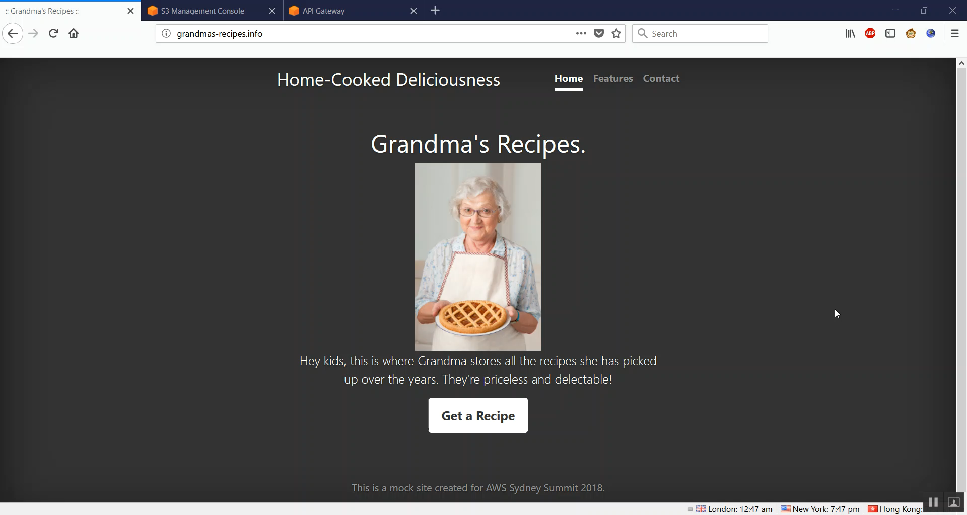

Slide 8
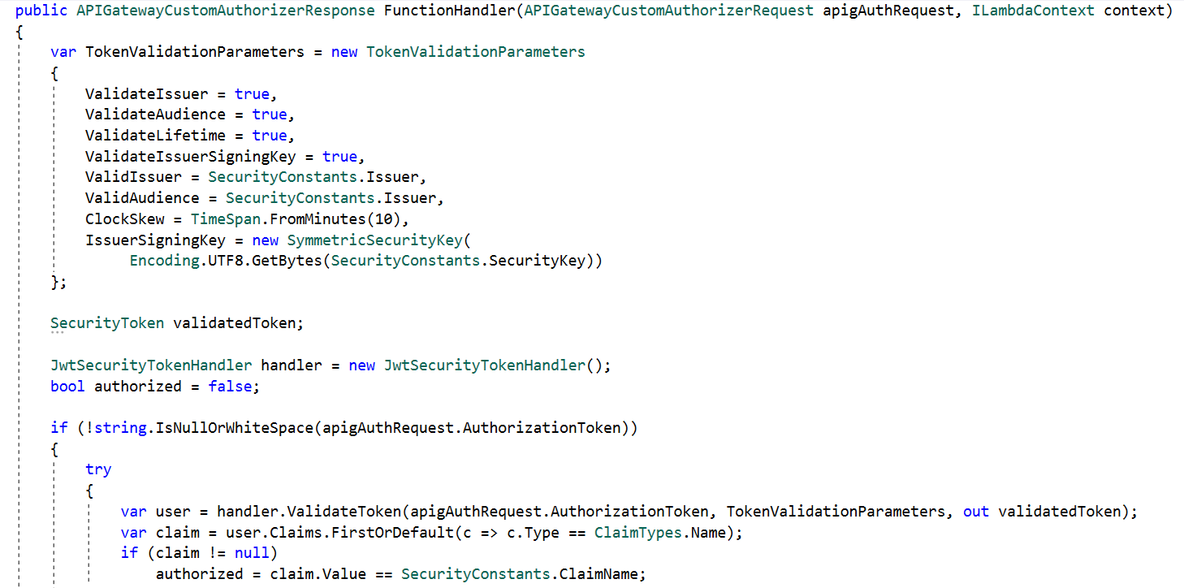
Validating a Token in a Custom Authorizer
1
2
3

Slide 9
Summary
Microsoft .NET is a first class citizen on AWS
The AWS Toolkit for Visual Studio simplifies deployment
Amazon.Lambda.* NuGet packages provide POCOs for .NET Lambda development
Use an authorisation strategy that suits your needs
Use a tool like Postman to test that your authorization is working

Slide 10
Want to Know More?
Talk to an AWS Team Member
Notes:
Badge at the back

